Slide 1
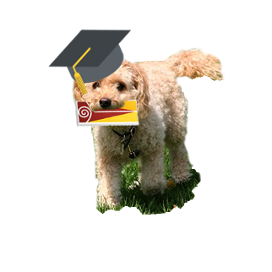
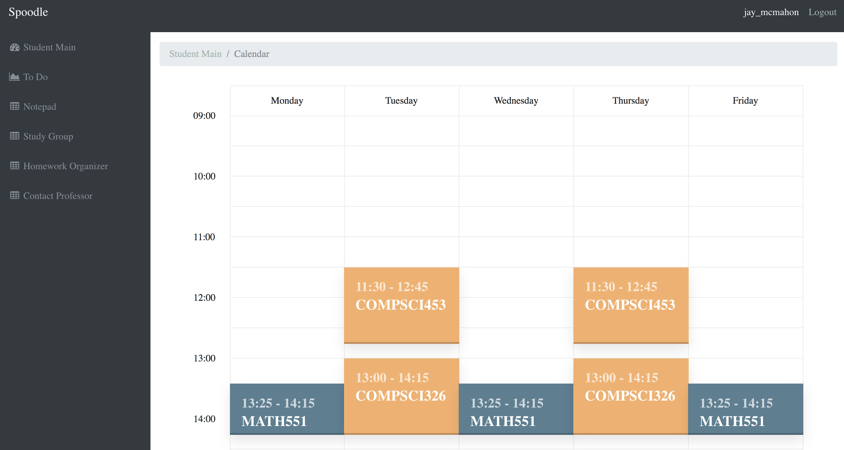
Spoodle
Jay McMahon
Aaron Traylor
Quentin Small
Logan Cotto

